Slide 1
WaitLess - Group 2
By:Ammar Idrees
Maaz Ahmed
Bryan Gutierrez
Zaid Patel

Slide 2
What is Waitless?
Management application specifically for Waiters
Control available tasks
Table display to view available tables
Can choose where you place customers
Statistics to determine how busy the restaurant is
“Wait-Less is a management product that will allow restaurants to increase efficiency to increase its profits”

Slide 3

Features
Login Page
Table display
Stats screen
Menu
Tasks List
Optimal Route algorithm

Slide 4
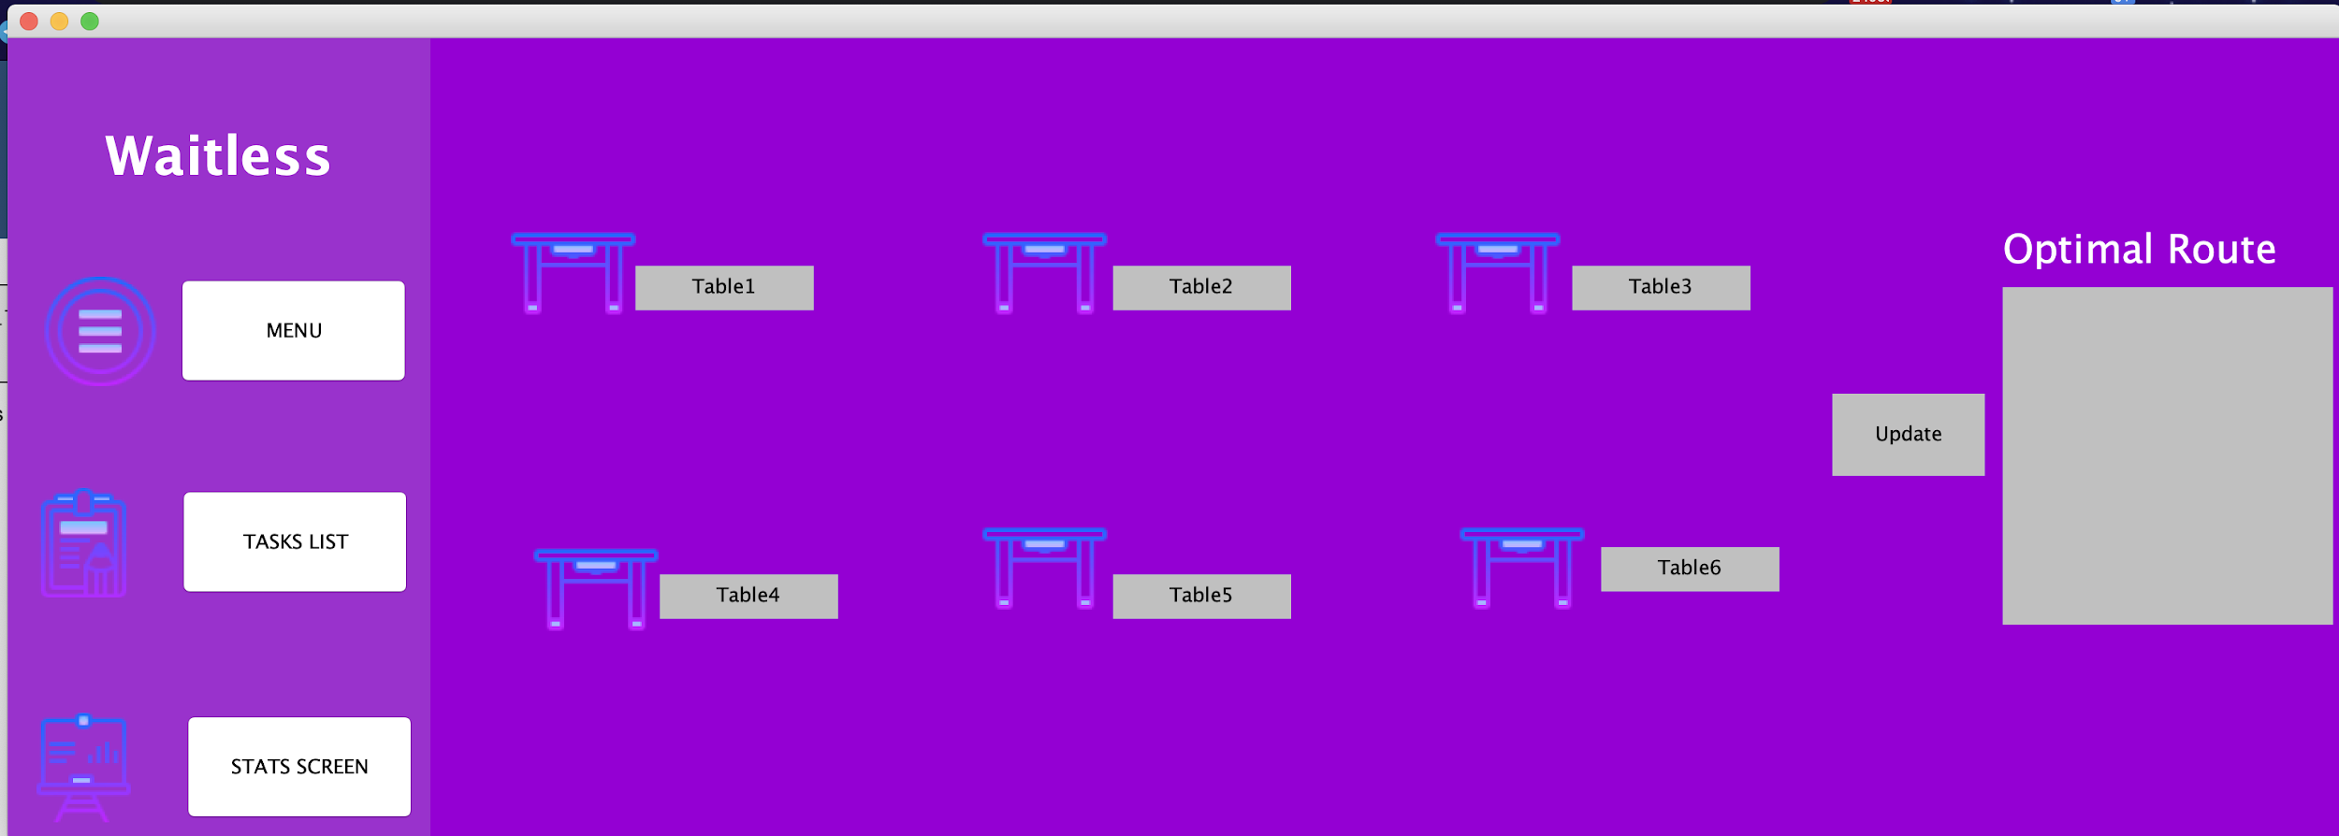
Table Display
Main menu of program
Waiter will be able to access:
Menu to take orders
Task list for the shift
View statistics (for now…)
Tables can be tracked
Occupied/Available
Keep track of how long table is occupied
Optimal Route Algorithm
Makes a queue based on table order price to serve those with less food first

Slide 5
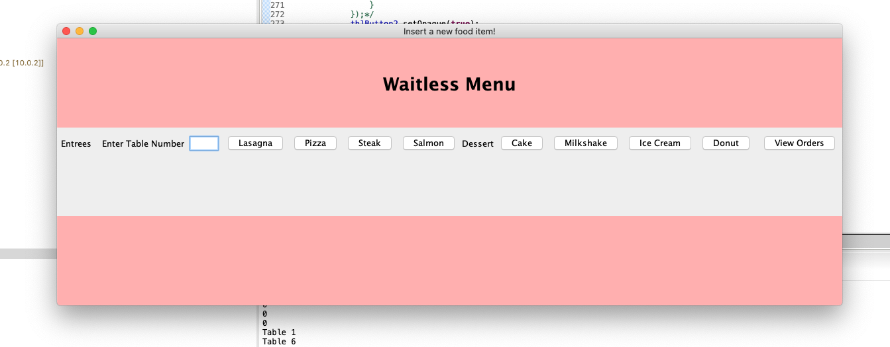
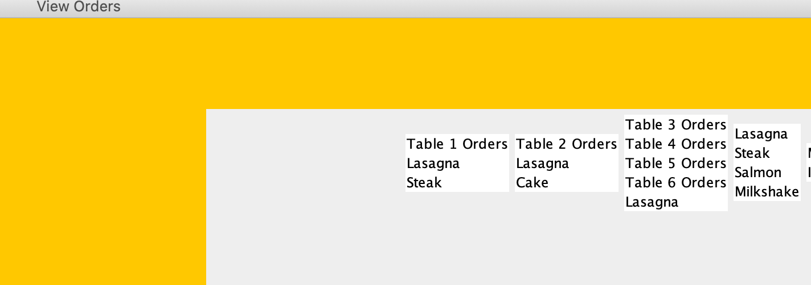
Menu
-Menu allows tables to choose an item, and immediately lists out the price
-A separate tab lists all the items that are ordered for a specific table.

Slide 6
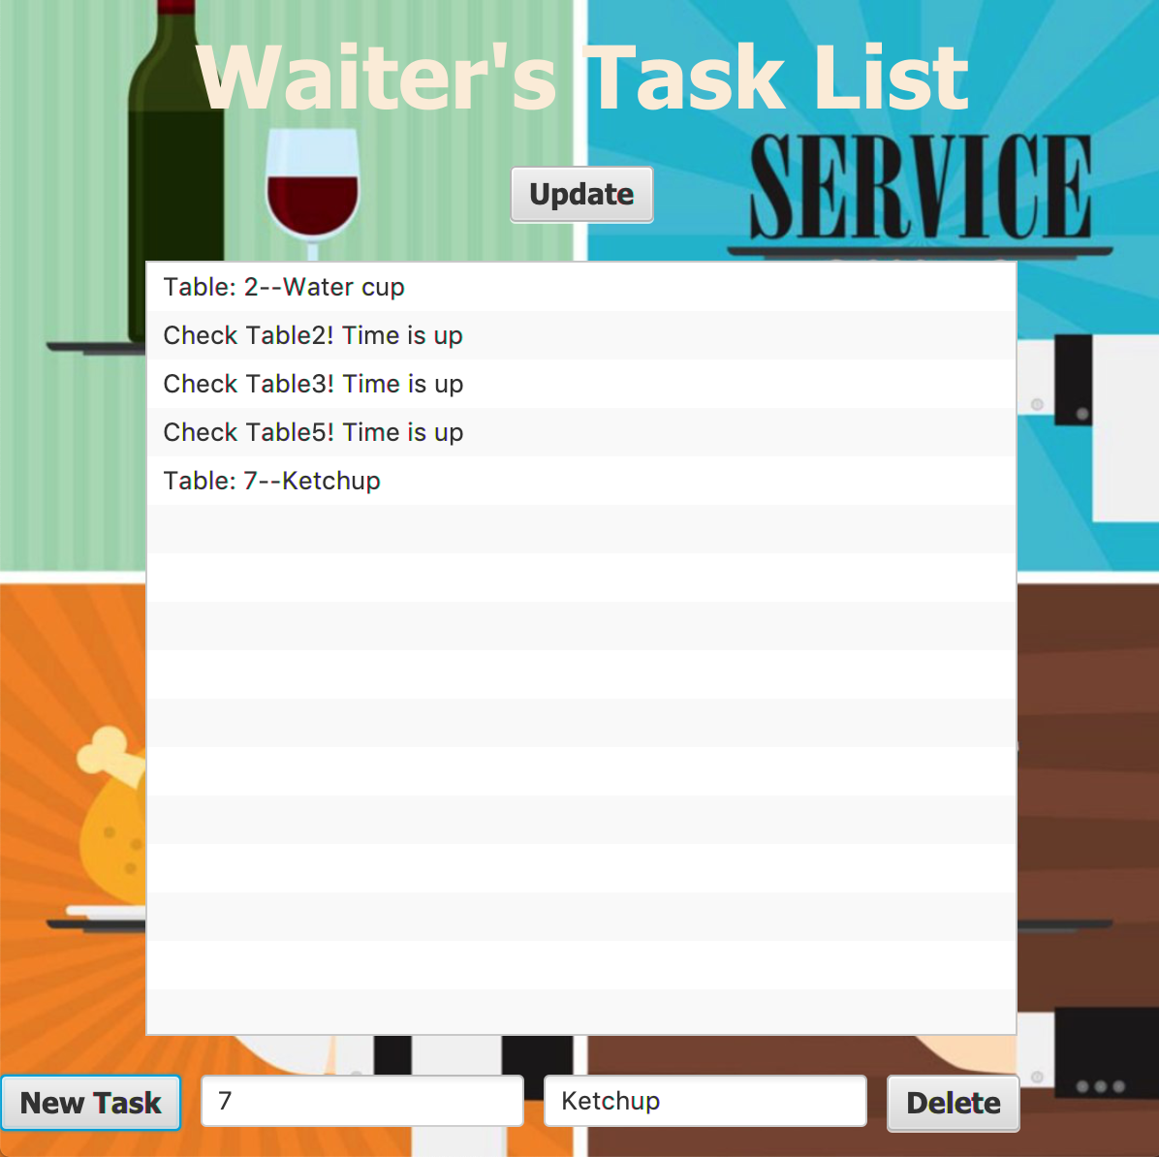
Tasks List
Add Tasks to the List
Input table # and Task
Delete Task
Select a Task or pop first
Check Table -> Timer

Slide 7
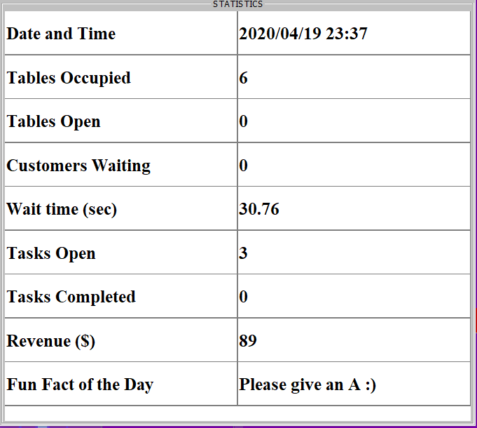
Stats Screen
View different useful stats
Date and Time
Table status
Tasks
Revenue
Wait time
A fun fact :)

Slide 8
How it was accomplished
Future Plans
Account creation with database
Multiple accounts at the same time
Have manager log in
Menu
Add more menu items and features
Task List
Have a notification system that notifies waiters
Stats
More stats
Access
Scrum Methodology
Icescrum
Weekly Minutes
Open communication
GitHub
Good Teamwork

